Slide 1
SMART DOOR
컴퓨터공학과 신은섭 이규태

Slide 2
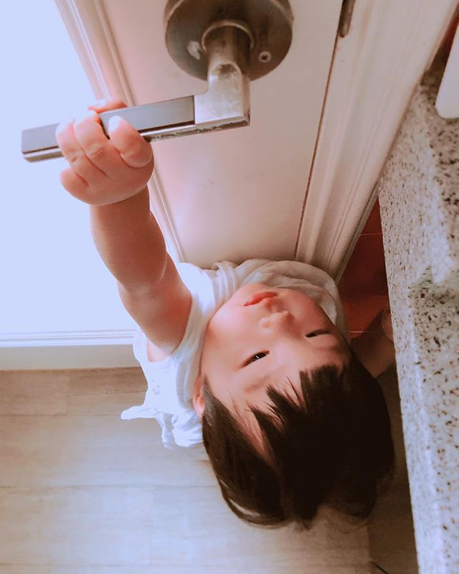

OVER VIEW

Slide 3

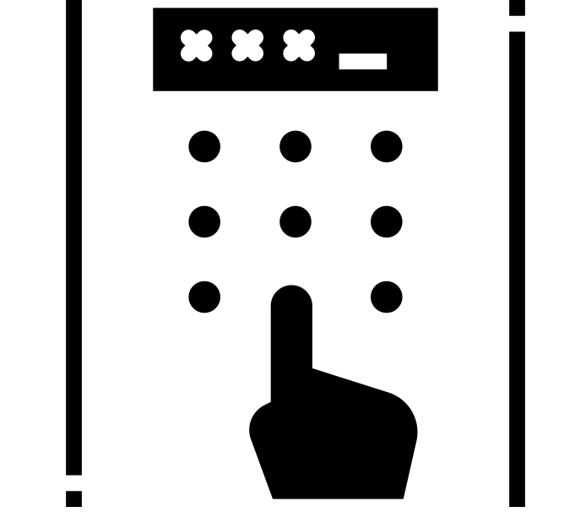
Goal
NO Password, Just Open, Only Approved

Slide 4




Requirement
User Controller
Communication
IOT Controller
AWS

Slide 5


Approach
Send a signal continuously
Detect signal and send open signal
문에 부착된 장치가 블루투스 신호를 지속적으로 보냄
어플리케이션이 블루투스와 페어링 후 열림 신호를 전송함
장치가 등록된 사용자인지 확인 후 문이 열림

Slide 6
Development Environment
Content | Detail
IOT Board | Raspberry pi 3 b
IOT OS | Raspbian Stretch
Android OS | Android 8.0.0
Development Language | Python
IDE | VS code

Slide 7
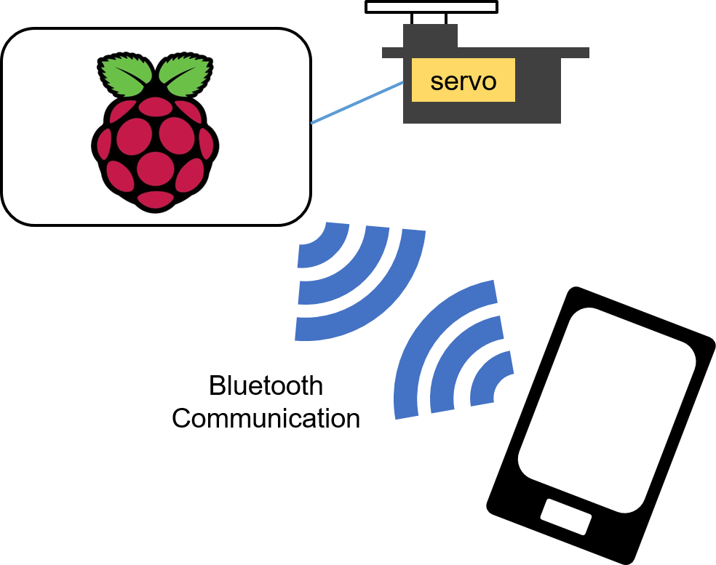
Architecture

Slide 8
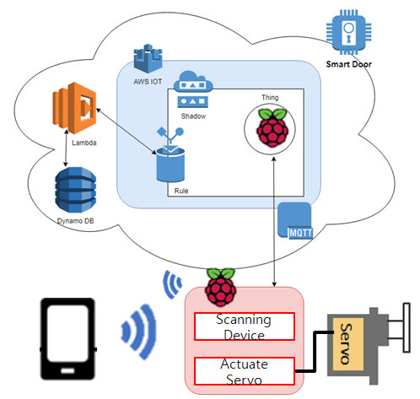
Architecture

Slide 9
Basic Spec
1. Bluetooth
2. Control Servo Motor
3. Receive ‘Open’ message and open door
Pairing and Sent ‘Open’ message

Slide 10
Current Status
Connection with Smart Phone
- Continuous device discovery using Bluetooth
- Pairing Device
IOT

Slide 11

Current Status
1. Door ID Update
저희 Smart Door은 보안을 위해 일정 주기로 Door ID를 Update 합니다.

Slide 12
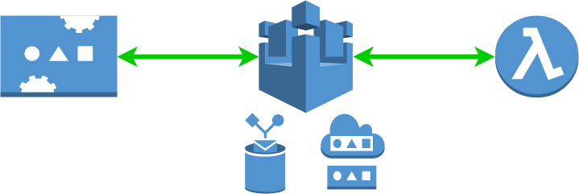
Current Status
1. Door ID Update

Slide 13
Current Status
1. Door ID Update
0. Initial State
{
"reported": {
"state": "Active",
"doorid": "P789G8GP"
}
}

Slide 14
Current Status
1. Door ID Update
1. ID Request
{
"desired": {
"state": "RequireNewID",
},
"reported": {
"state": "RequireNewID",
"doorid": "P789G8GP"
}
}
1

Slide 15
Current Status
1. Door ID Update
2. Capture Request
SELECT *, topic(3) as thingName
FROM '$aws/things/+/shadow/update'
WHERE state.desired.state = 'RequestNewID'
2

Slide 16
Current Status
1. Door ID Update
3. Genereate New ID
{
"desired": {
"state": "Active",
"doorid": "CRWI5SCT"
},
"reported": {
"state": "Active",
"doorid": "P789G8GP"
} }
3

Slide 17
Current Status
1. Door ID Update
4. Genereate New ID
{
"reported": {
"state": "Active",
"doorid": "CRWI5SCT"
}
}
4

Slide 18
Division & Assignment of Work
항목 | 담당자
Bluetooth Beacon | 이규태
Control Servo Moter | 신은섭
Receive ‘Open’ message and open door | 신은섭
Scan Bluetooth beacon and Send Open Message | 이규태

Slide 19
Schedule
내용 | 9월 |  |  | 10월 |  |  |  | 11월 |  |  |  | 12월
 | 2 | 3 | 4 | 1 | 2 | 3 | 4 | 1 | 2 | 3 | 4 | 1 | 2
Bluetooth Beacon
Issue New Thing ID
Control Servo Moter
Receive ‘Open’ message and open door
Scan Bluetooth beacon and Sent Open Message
Bug Fix and Demo test

Slide 20
Q&A

